Slide 1
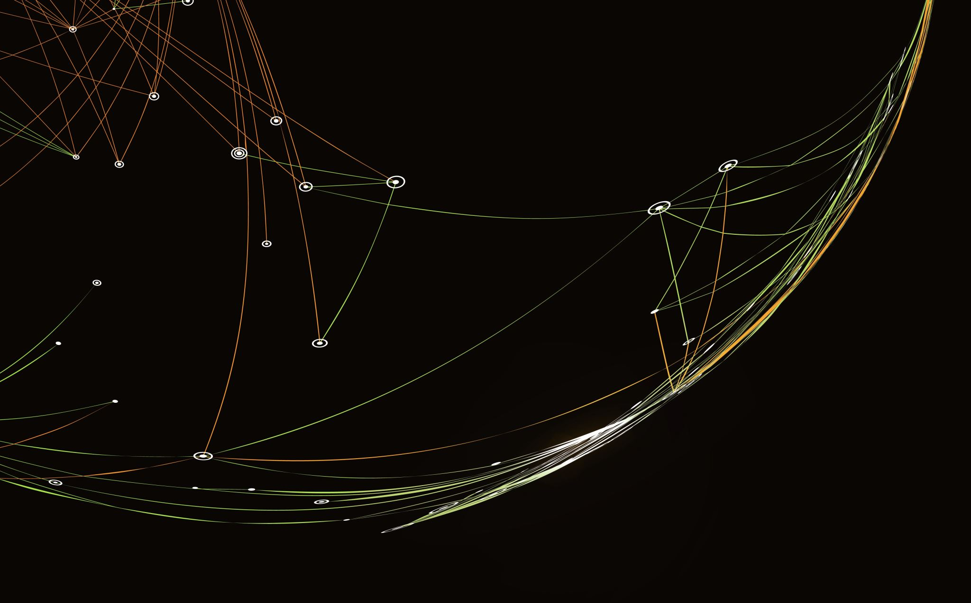
5215 Machine Learning
Group Number: 8
Team Members:
HIMAJA BOINAPALLY (11699781)
JYOTHIKA RAJ SAMINENI (11591327)
KEVIN ARASAI PIRUTHIVIRAJ (11719426)
LAKSHMI SUREKHA MADDUKURI (11668798)

Slide 2
FAKE JOB PREDICTION USING MACHINE LEARNING

Slide 3
Introduction
The goal of a fake job prediction using machine learning project is to create a system that can quickly and accurately detect and flag fraudulent job listings on online job portals or websites.
This is crucial to safeguarding job searchers from scammers and maintaining the credibility of job markets

Slide 4
Problem Statement
Dealing
Dealing with imbalanced data.
Handling
Handling missing values.
Removing
Removing Duplicates.
Sampling
Sampling the dataset.
Outliers
Addressing outliers.
Predicting
Predicting whether a job posting is genuine or fraudulent.
Addressing
Addressing fake job postings in online platforms.

Slide 5
Contd..
The problem of identifying fraudulent job postings is tackled by first preprocessing a dataset.
Applying three different machine learning models: Logistic Regression, K-Nearest Neighbors, and Random Forest Classifier.
The effectiveness of each model is evaluated based on their accuracy in predicting fraudulent job postings, using a split of training and testing data from the preprocessed dataset.
Improved model accuracy by hyper parameter tuning.

Slide 6
Model & Methodology
Methods:
Logistic Regression
K-Nearest Neighbors
Random Forest Classifier
Evaluation Metrics:
Accuracy
Precision
Recall
Hyper-parameter tuning:
Cv grid search

Slide 7
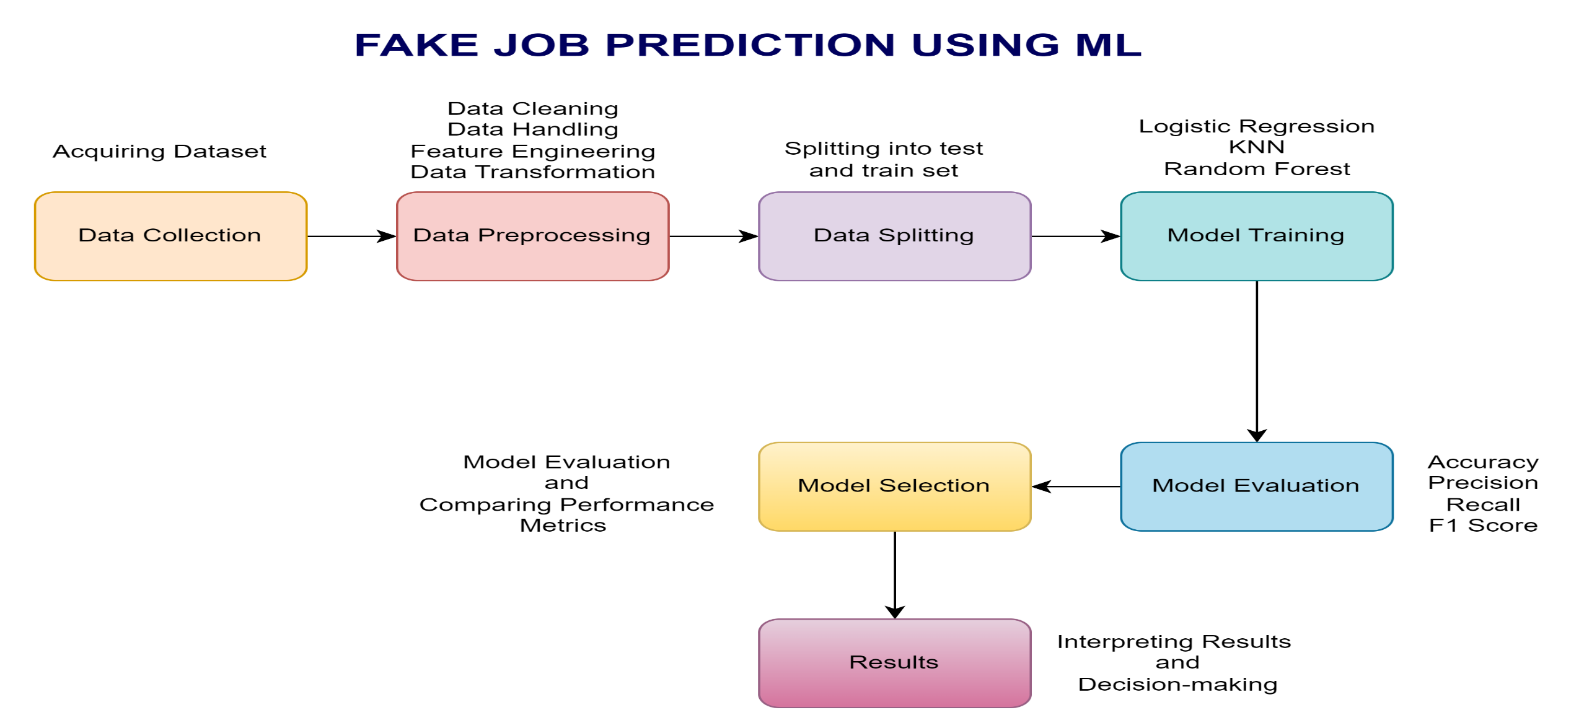
Workflow Diagram

Slide 8
Dataset
This project relies on a variety of features, which are traits or qualities of job postings. The accuracy and efficiency of the model depend greatly on the feature selection. The following are some typical features in our project
Job Title
Company Profile
Requirements
Compensation and Benefits
Location
Application Procedure
Contact Information
URL analysis
Images, logos, and multimedia material are examined in this image and logo analysis.

Slide 9
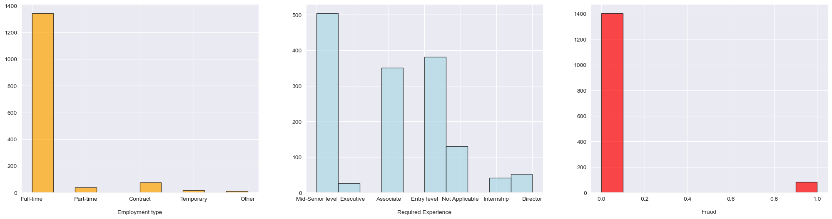
The distribution of employment types is represented in the first histogram, consisting of "full-time" employment. In the second histogram, the most common experience requirements for job postings are 'Entry Level' and 'Mid-Senior level’. The third histogram displays a binary distribution of the data regarding whether a job posting is fraudulent, with the majority of postings being non-fraudulent.

Slide 10
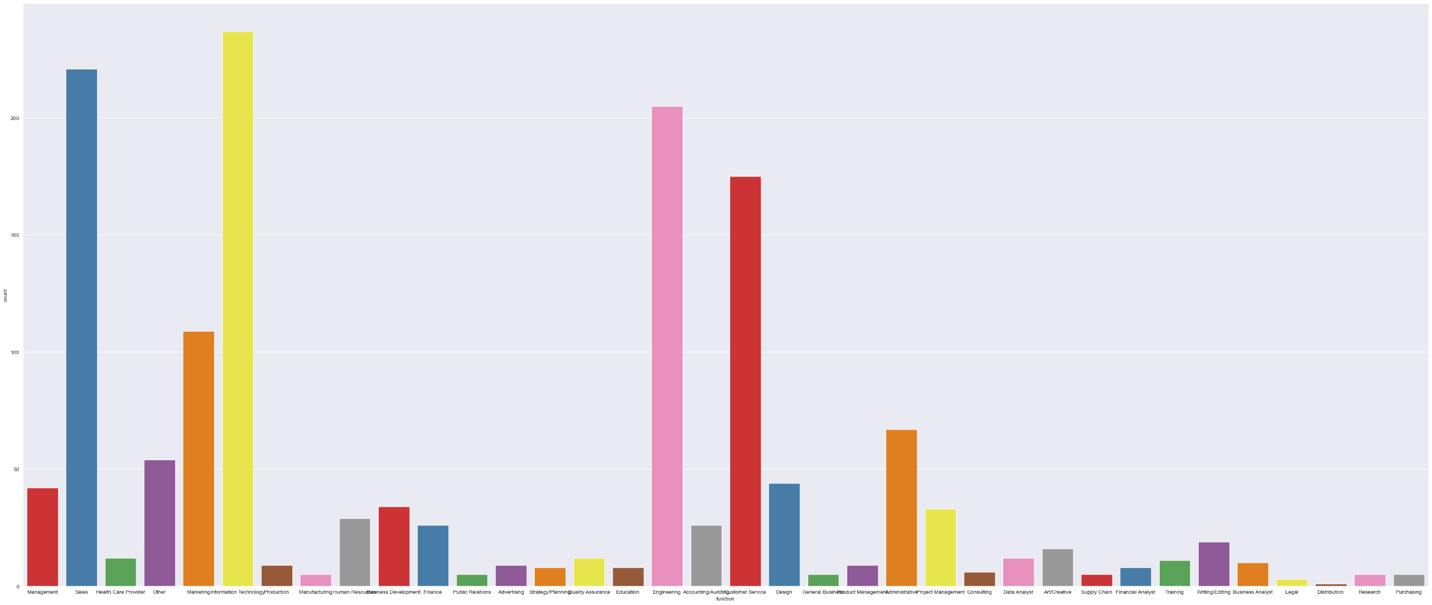
A bar chart with different job functions on the horizontal axis and their corresponding counts on the vertical axis

Slide 11
Data pre-processing
EDA
Importing libraries
Exploring dataset
Feature selection
Handling missing values
Normalization and scaling.
Removing outliers

Slide 12
Implementation
Algorithms:
Logistic Regression
KNN
Random Forest
libraries used:
scikit-learn
Pandas
seaborn
Reasoning behind using specific libraries:
Seaborn for data visualization
Pandas for data manipulation and analysis.
Scikit-learn for predictive data analysis.

Slide 13
Implementation
The code's implementation approach is based on an organized machine learning workflow, which entails cleaning and preparing the data first, then visualizing it to identify underlying distributions and patterns.
In order to rectify class imbalances, the dataset is balanced and feature engineering is utilized to translate categorical variables into numerical values.
The preprocessed data is used to train and assess a variety of machine learning models, including Random Forest, K-Nearest Neighbors, and Logistic Regression.
Lastly, accuracy is used as the primary metric to evaluate the model's performance and determine how effective the predictions are.
Performed hyper parameter tuning on logistic regression and random forest and increased the accuracy.

Slide 14
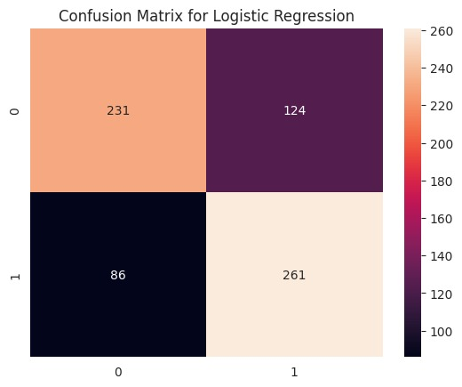
Confusion matrix for Logistic Regression
The Logistic Regression confusion matrix shows that 231 non-fraudulent and 261 fraudulent job postings were correctly predicted by the model, but 124 non-fraudulent and 86 fraudulent job postings were incorrectly identified as fraudulent. The significant amount of misclassifications suggests that the precision and recall of the model need to be improved.

Slide 15
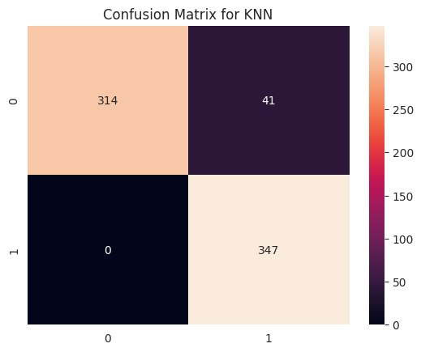
Confusion matrix for KNN
The confusion matrix for the K-Nearest Neighbors (KNN) algorithm reveals that, while it misclassified 41 non-fraudulent postings as fraudulent (false positives), it correctly predicted 314 true negatives (non-fraudulent postings) and 347 true positives (fraudulent postings), with no false negatives. This suggests that the model is very sensitive to the positive class and shows a high degree of accuracy in detecting fraudulent postings while maintaining a low error rate for false negatives.

Slide 16
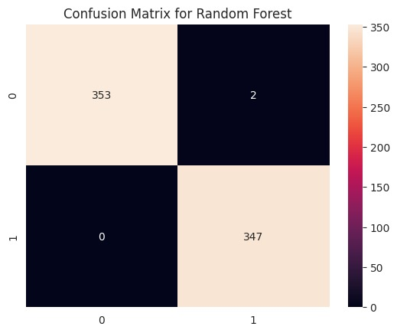
Confusion matrix for Random Forest
With only 2 false positives and no false negatives, the Random Forest classifier's confusion matrix demonstrates the model's high accuracy, correctly predicting 353 true negatives and 347 true positives. This suggests that the Random Forest model performs exceptionally well in classifying job postings as fraudulent or not, with a notable capacity to detect all instances of fraud without missing any.

Slide 17
Comparison of the models
 | Accuracy | Precision | Recall | F1-Score
Logistic Regression | 70.08% | 0.6779 | 0.7521 | 0.7131
K-Nearest Neighbors | 94.15% | 0.8943 | 1.0 | 0.9442
Random Forest | 99.71% | 0.9942 | 1.0 | 0.9971

Slide 18
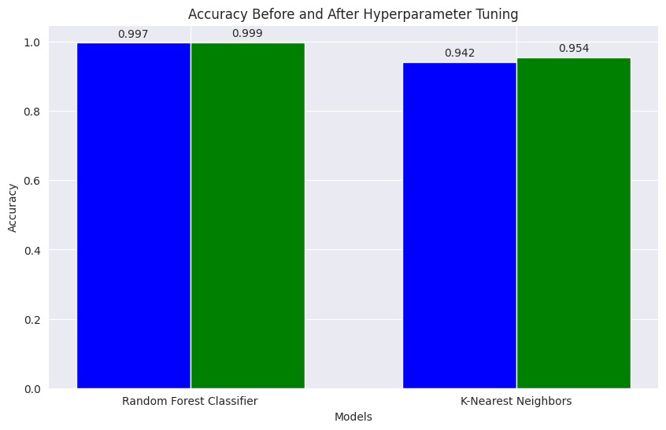
Comparison of the models after hyper tuning

Slide 19
Analysis
With an accuracy of 70.08%, precision of 0.6779, recall of 0.7521, and F1-score of 0.7131, Logistic Regression performs the worst, suggesting it might not be the ideal model for this specific issue.
With a high accuracy of 94.15%, excellent precision of 0.8943, perfect recall (1.0), indicating that it correctly identified all actual positives, and a high F1-score of 0.9442, which strikes a balance between precision and recall, K-Nearest Neighbors demonstrates a notable improvement.
With an exceptional accuracy of 99.71%, nearly perfect precision of 0.9942, perfect recall, and an F1-score of 0.9971, Random Forest has the highest metrics overall, indicating a very strong performance and indicating it is probably the best model out of the three for this dataset.
The accuracy has been increased from 94.15% to 95.40% for the Knn by using hyper parameter tuning.
The accuracy has been increased from 99.71 % to 99.99% for the Random forest by using hyper parameter tuning.

Slide 20
Project Management
Member | Task Worked on | Contribution
Kevin | Surfed various sites for selecting the best dataset and contributed 40% to the preprocessing of the dataset. Partially worked on the implementation of the logistic regression model. | 100% 100%
Jyothika | Contributed 60% to Data preprocessing Implementation of logistic regression model. | 100% 100%
Himaja | Implementation of KNN model Worked on the implementation of hyperparameters in the KNN model for increasing accuracy. | 100% 100%
Surekha | Implementation of the Random Forest model Worked on the implementation of hyperparameters in the Random Forest model for increasing accuracy. | 100% 100%

Slide 21
References
https://towardsdatascience.com/fake-job-predictor-a168a315d866
Panov, P., Soldatova, L. and Dzeroski, S. (2013) OntoDM-KDD: Ontology for Representing the Knowledge Discovery Process. 16th International Conference on Discovery Science, Singapore, 6-9 October 2013, 126-140.https://doi.org/10.1007/978-3-642-40897-7_9
Diwathe, D. and Dongare, S. (2017) Classification Model Using Optimization Technique: A Review. International Journal of Computer Science and Network, 6, 42-48
Kukasvadiya, M. and Divecha, N., International Journal of EngineeringDevelopment and Research, 5, 836(2017)
Jyoth, P., Siva Ranjani, R., Mishra, T. and Mishra, S.R. (2017) A Study of Classification Techniques of Data Mining Techniques in Health Related Research. International Journal of Innovative Research in Computer and Communication Engineering, 5, 13779-137876

Slide 22
Presentation Link
https://myunt.sharepoint.com/sites/ml524/_layouts/15/stream.aspx?id=%2Fsites%2Fml524%2FShared%20Documents%2FGeneral%2FRecordings%2FNew%20channel%20meeting%2D20231130%5F181502%2DMeeting%20Recording%2Emp4&nav=eyJyZWZlcnJhbEluZm8iOnsicmVmZXJyYWxBcHAiOiJTdHJlYW1XZWJBcHAiLCJyZWZlcnJhbFZpZXciOiJTaGFyZURpYWxvZy1FbWFpbCIsInJlZmVycmFsQXBwUGxhdGZvcm0iOiJXZWIiLCJyZWZlcnJhbE1vZGUiOiJ2aWV3In19&ga=1&referrer=StreamWebApp%2EWeb&referrerScenario=AddressBarCopied%2Eview

Slide 23

Thank You

